Slide 1
Sentiment Analysis of Apple Tweets
Group 5 :
Prajwal Kadam Deepak Gavit Rushikesh Kale Suyash Gaikwad
Rahul Nagpure

Slide 2
INTRODUCTION
Twitter is an online news and social networking service that enables users to send and read short 140-character messages called "tweets". Registered users can read and post tweets, but those who are unregistered can only read them. Hence Twitter is a public platform with a mine of public opinion of people all over the world and of all age categories. As of October 2016, Twitter has more than 315 million monthly active users. Twitter Sentiment Analysis is the process of determining the emotional tone behind a series of words, used to gain an understanding of the attitudes, opinions and emotions expressed within an online mention.

Slide 3
SCENARIO
We are performing sentiment analysis of tweets about apple company before and after release of quarterly earnings report.After performing this activity,we interpret the results of the analysis by various graphs, wordclouds,etc

Slide 4
OBJECTIVES
Understand the concepts of sentiment analysis.
Understand the process of how to extract useful information from huge datasets.
Perform text/data pre-processing activities.
Analyse and visualize the sentiment analysis of Apple Company before and after quarterly earnings report.

Slide 5
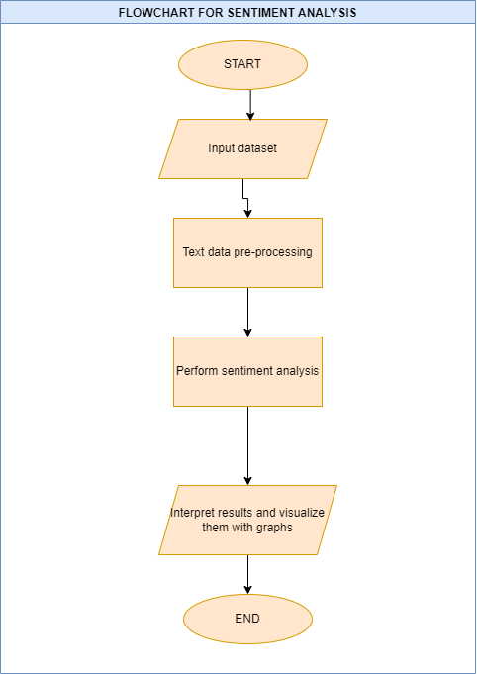
FLOWCHART

Slide 6
CONCLUSION
We can clearly derive and understand how the sentiment of common people has changed with respect to Apple Company before and after the earnings report. We also appreciated the most commonly used words in tweets. Also we learnt about different packages and cleaning the dataset especially in such cases where we are trying to extract crucial business data from subjective sentences.

